Slide 1
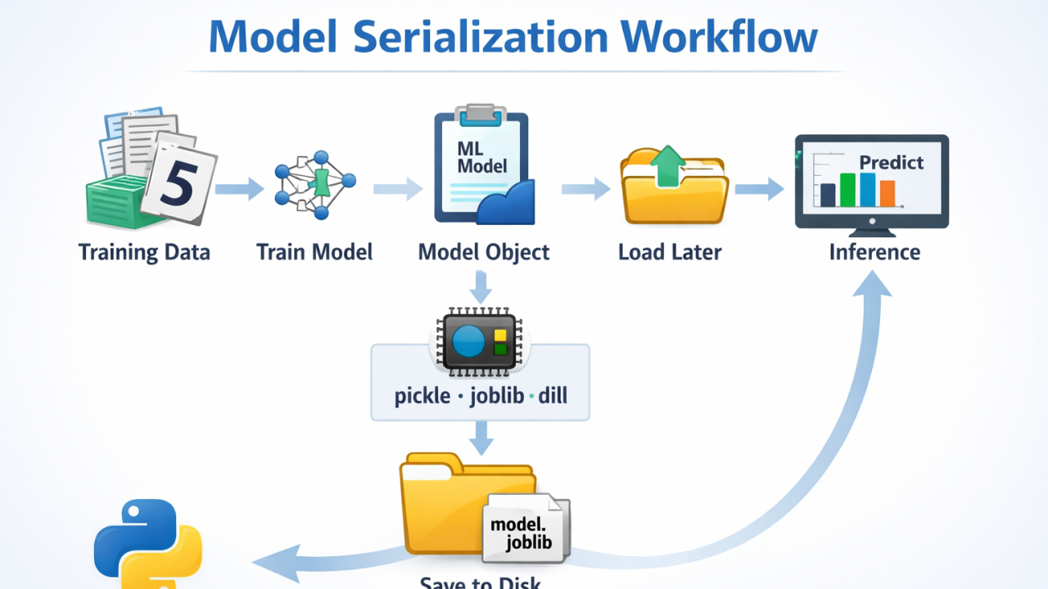
Model Serialization (Saving & Loading)
Exporting the "Brain" of Your AI
Instructor: Zaryab Ahmad Khan

Slide 2
The Concept of Serialization
The Problem: Training a model can take minutes, hours, or even days depending on the data size. You don't want to retrain the model every time you want to make one prediction.
The Solution: Serialization.
Definition: Converting the trained model object into a byte stream (a file) that can be stored on a hard drive and reloaded later.

Slide 3
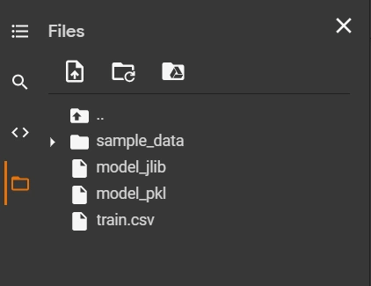
Using Pickle & Joblib
Pickle: The standard Python library for serializing objects.
Joblib: A library optimized specifically for large NumPy arrays and Scikit-Learn models. It is usually faster and more efficient for ML models than standard Pickle.
Files: These models are typically saved with the .pkl or .joblib extension.

Slide 4
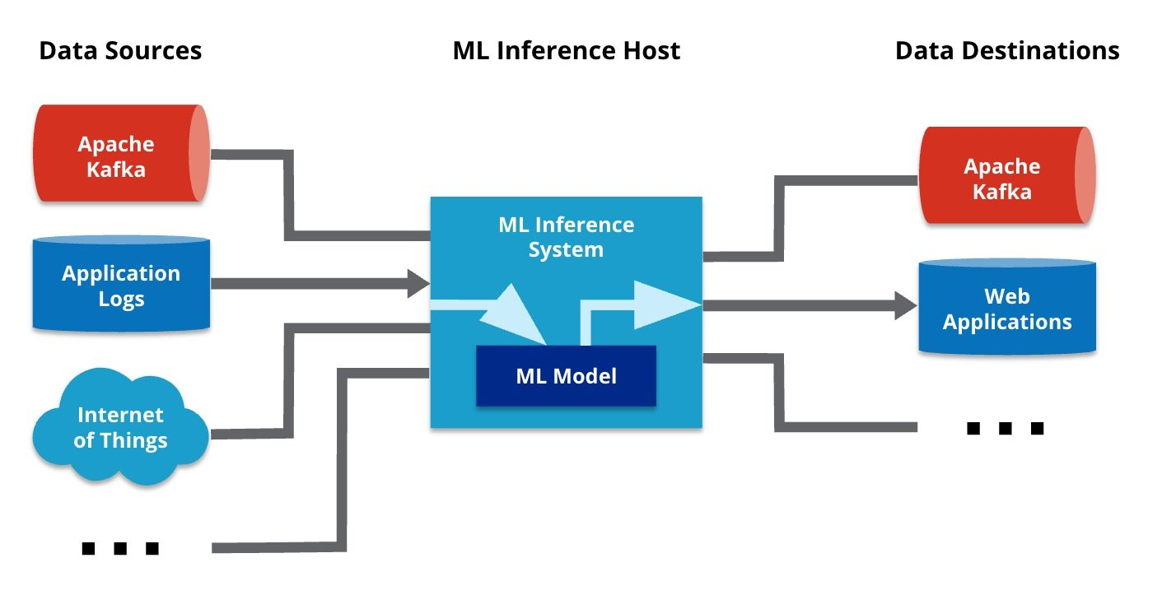
The Inference Script
Inference: The process of using a trained model to make a prediction on new, live data.
The Script: In a production environment, you write a separate, lightweight script that:
Loads the saved model file.
Accepts input from a user (like a website form or a sensor).
Outputs the prediction instantly without any training code involved.

